Slide 1



HR Analytics Dashboard using Tableau
Notes:
1

Slide 2

Contents
Introduction
Problem Statement
Objectives
Purpose, Motivation and Target audience
Project Overview
Tableau Dashboard Design
Data Sources
Key Metrics and KPIs
Gender Based Attrition
Department-wise Attrition
Workforce by Age Group
Job satisfaction Ratings
Education field wise Attrition
Attrition by Gender and Age
Final Dashboard Overview
Key findings
Conclusion
Recommendations & Potential Interventions
Predictive Analytics Opportunities
Challenges and Future scope
Notes:
2

Slide 3
Introduction
What is HR Analytics?
Why Tableau?
Benefits
HR analytics uses data-driven insights to improve workforce management and organizational performance.
Tableau offers powerful visualization tools, making complex HR data accessible and actionable.
HR analytics enhances decision-making, improves employee engagement, and optimizes resource allocation.
Notes:
3

Slide 4

Problem Statement
High Employee Attrition Rate
Lack of Insights
Organizations face challenges in identifying and addressing factors contributing to employee turnover.
Traditional HR practices often fail to provide actionable insights for strategic decision-making.
Inefficient Processes
Job Satisfaction Disparities
Manual data analysis consumes time and resources, leading to delayed responses to workforce issues.
Uneven job satisfaction ratings across roles impact overall workforce morale and productivity..
Notes:
4

Slide 5





Objectives
Data Visualization
Insights Generation
Create clear, interactive visualizations of key HR metrics and trends.
Provide actionable insights to support data-driven HR decisions and strategies.
Process Optimization
Performance Enhancement
Streamline HR processes and improve overall operational efficiency.
Boost organizational performance through improved workforce management and planning.
Notes:
5

Slide 6


Purpose, Motivation and Target Audience
1
Purpose
To provide actionable insights into workforce dynamics using data-driven HR Analytics.
2
Motivation
Address high attrition rates and job satisfaction disparities with strategic solutions.
3
Target Audience
HR managers, team leaders, and decision-makers focused on workforce optimization.
4
Background and scope of the project
The project leverages HR Analytics and Tableau to analyze workforce dynamics, identify attrition trends, and provide actionable insights for improving employee retention and organizational performance.
Notes:
6

Slide 7
Project Overview
1
Planning
Define project scope, objectives, and key stakeholders. Identify data sources and metrics.
2
Data Preparation
Collect, clean, and integrate HR data from various sources. Ensure data quality and consistency.
3
Dashboard Design
Create interactive Tableau dashboards with relevant HR metrics and visualizations.
4
Implementation
Deploy the HR analytics dashboard and train users on its features and benefits.
Notes:
6

Slide 8

Tableau Dashboard Design
1
User-Centric Design
2
Interactive Visualizations
Intuitive layout and navigation for easy access to key HR insights.
Dynamic charts and graphs allowing users to explore data in-depth.
3
Customizable Views
4
Mobile Responsiveness
Filters and parameters for personalized data analysis and reporting.
Optimized design for access on various devices, ensuring on-the-go insights.
Notes:
8

Slide 9

Data Sources
Kaggle Dataset:
HR Data Fields
The dataset used for this project was sourced from Kaggle, a popular platform for sharing datasets and machine learning challenges. It contains employee data, including demographics, job satisfaction, performance metrics, and attrition details.
Employee demographics (age, gender, education).
Job-related information (department, roles, years at company)
Attrition details (voluntary and involuntary)
Job satisfaction ratings and performance scores
Notes:
7

Slide 10
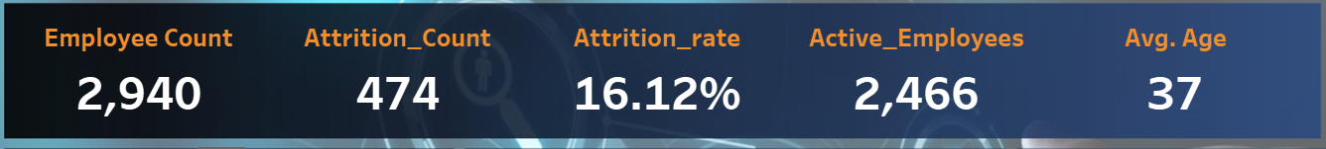
Metric
Description
Impact
Employee Count
Total number of employees currently in the organization
Provides baseline for workforce size.
Key Performance Indicators (KPI’s)
Attrition count
No. of employees who left the company
Employee turnover rate
Attrition rate
Percentage of employees who leaves company annually
Improve retention strategies
Active employees
No. of employees currently working.
Average age of current employees
Workforce Size
Age-specific workforce strategies
Average Age
Notes:
9

Slide 11
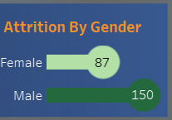
Gender Based Attrition
Female Attrition
Analyze attrition rates among female employees, focusing on job satisfaction, work-life balance, career progression to implement tailored retention plans.
Male Attrition
Explore male employee attrition patterns, addressing challenges related to the career growth, recognition and workplace culture to retain valuable talent.
Notes:
11

Slide 12
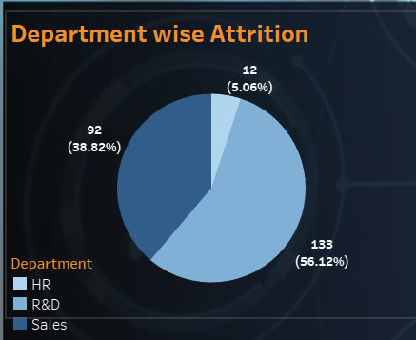
Department Wise Attrition
Department
Attrition Rate
Sales
38.82%
R&D
56.12%
HR
5.06%
Notes:
12

Slide 13
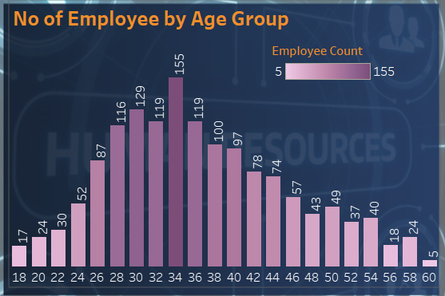
Workforce by Age Group
Dominant Age Groups
The age groups 30–34 and 35–39 have the highest number of employees, with 155 and 129 employees, respectively.
Older Employees
Employees aged 50 and above represent a smaller portion of the workforce, with counts decreasing progressively in the older age brackets.
Younger Employees
The younger age groups, such as 20–24 and 25–29, have fewer employees, with counts of 24 and 52 respectively.
Notes:
13

Slide 14

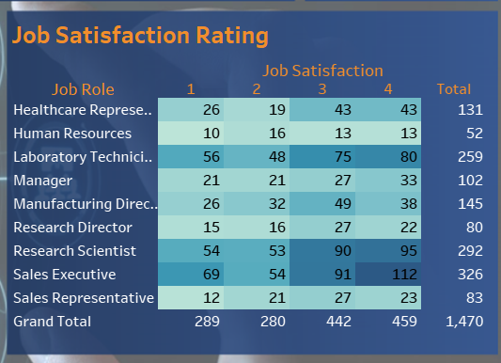


Job Satisfaction Ratings
Low Satisfaction Areas
Identify areas where employee satisfaction is lower and prioritize interventions to address these concerns.
High Satisfaction Areas
Recognize aspects that contribute to high job satisfaction and leverage these strengths to foster a positive work environment.
Continuous Improvement
Implement ongoing feedback mechanisms to gather employee insights and make continuous improvements to enhance overall job satisfaction.
Notes:
14

Slide 15
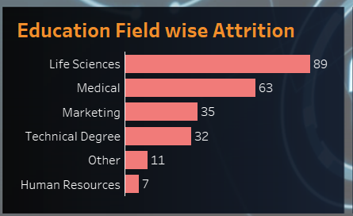
Education Field Wise Attrition
Life Sciences
Medical
The highest attrition count is from employees with a background in Life Sciences, totaling 89 might be facing challenges due to job satisfaction and career growth.
Medical professionals account for the second-highest attrition count, with 63 employees leaving due to job related stress, workload issues, better opportunities.
Other Fields
The "Others" category, including non-specific fields, Technical Degrees (32), and Marketing (35), have significantly lower attrition counts compared to Life Sciences and Medical. HR with lowest attrition of only 7.
Notes:
15

Slide 16
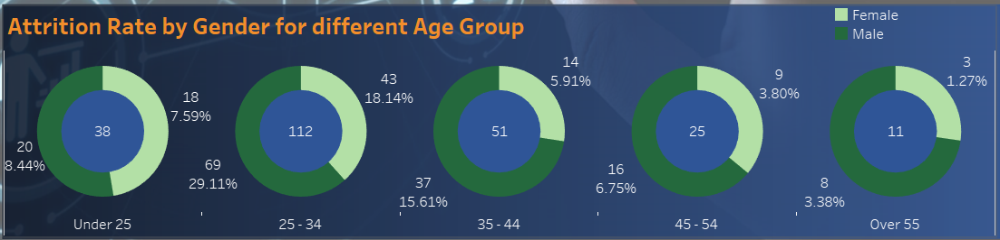
Attrition by Gender and Age
Male attrition is consistently higher than female attrition in most age groups, suggesting a potential need to explore male-specific retention challenges.
The 25–34 age group has the highest attrition, indicating a pivotal area for intervention through career growth and engagement strategies.
Notes:
16

Slide 17
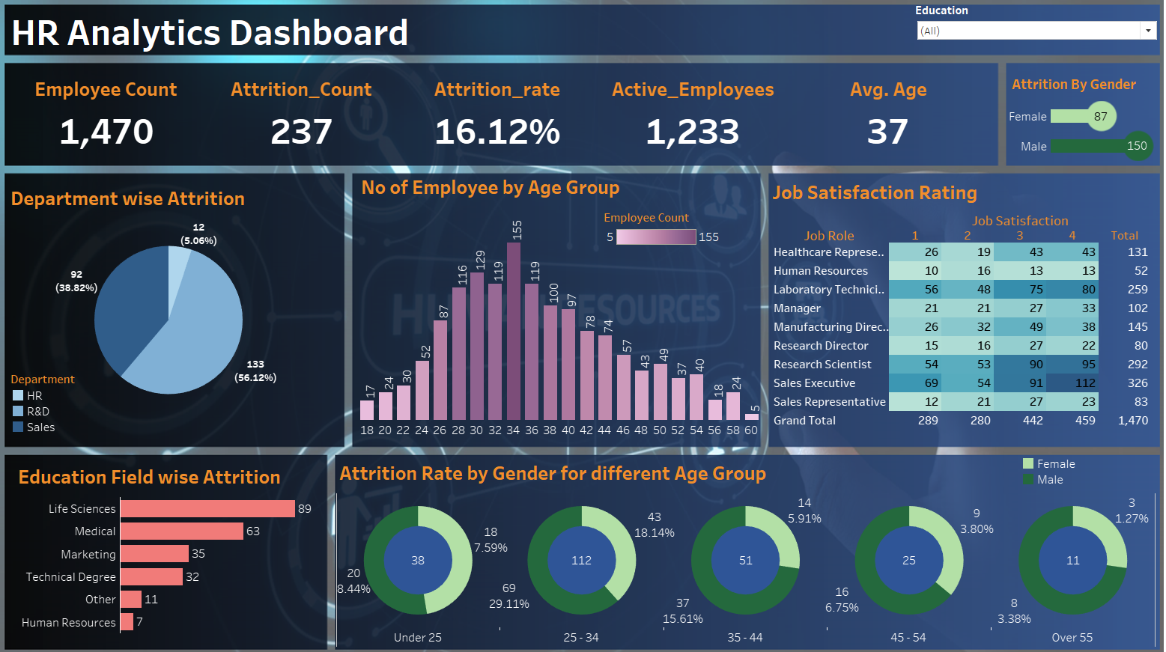
Final Dashboard Overview
Notes:
17

Slide 18
Key Findings
Overall Attrition Rate: The organization attrition rate is 16.12%, with a workforce of 1470 employees.
Gender Based Attrition: Male attrition is (150 employees) significantly higher than a female attrition (87 employees).
Department wise Attrition: R&D department has the highest attrition while HR department has the lowest attrition.
Education field insights: Life sciences professionals has the highest attrition indicating potential dissatisfaction and better external opportunities.
Age group Dynamics: Attrition is peak in 25-34 age group, highlighting retention challenges for early career professionals.
Job satisfaction variability: Certain roles show significantly lower satisfaction ratings, emphasizing the need to improve employee engagement and retention.
Notes:
18

Slide 19
Conclusion
HR Analytics Dashboard provides valuable insights into workforce dynamics, highlighting key areas such as attrition trends, departmental challenges, gender disparities, and age-specific patterns.
Notes:
21

Slide 20

Recommendations
Focus on High attrition departments.
Address gender disparities
Target age specific retention
Improve job satisfaction
Focus on education specific challenges
Notes:
19

Slide 21
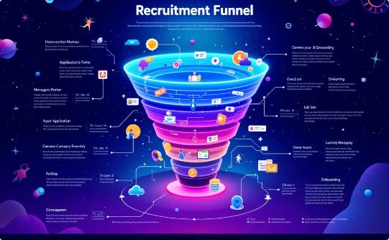
Potential Interventions
Employee engagement programs.
Career path and training
Exit interviews
Technology driven HR solutions
Mentorship and support networks
Notes:
19

Slide 22
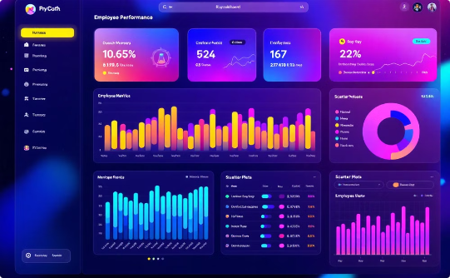
Predictive Analytics Opportunities
Attrition prediction.
Retention strategies
Workforce planning
Role suitability Analysis
Impact of engagement programs
Notes:
19

Slide 23
Challenges
High attrition rates in critical departments and age groups.
Limited data accuracy and potential bias in analysis
Notes:
21

Slide 24
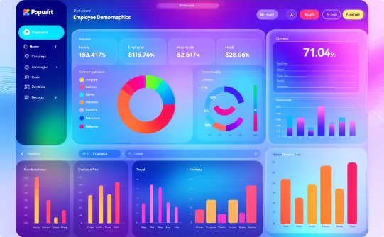
Future scope
Integrate advanced predictive analytics for proactive decision making
Expand metrics to include employee well-being, productivity, and diversity.
Notes:
21

Slide 25

Thank you
Notes:
22

